Slide 1
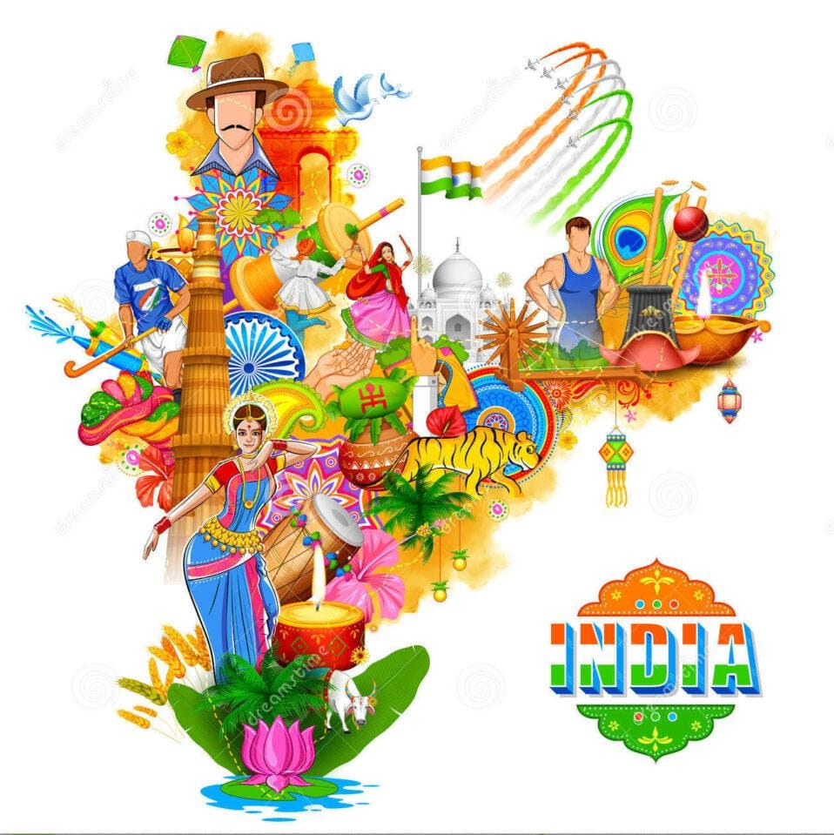
INDIAN CULTURE MANAGEMENT SYSTEM

Slide 2

TEAM MEMBERS:
CH.GNANA PRASUNNA - 2200030341
T.SAI SUSHMA-2200030339
D.RAJA MOUSHMI-2200030763

Slide 3
ABSTARCT:
The Indian Culture Management System is a web-based platform created to preserve, advance, and oversee India's rich cultural heritage. As an online repository, it provides comprehensive information on Indian traditions, art forms, festivals, historical landmarks, and cultural events. The system's main goal is to enhance awareness and appreciation of Indian culture, offering educational resources and fostering cultural exchange among a diverse audience. By serving as a central hub for exploring and understanding India's cultural legacy, this system plays a pivotal role in safeguarding and globally promoting its cultural heritage.

Slide 4
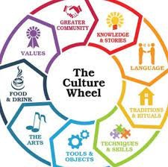
Introduction
The Indian Culture Management System is a web-based application that aims to preserve, promote, and manage the rich and diverse cultural heritage of India. The system provides a comprehensive platform for users to learn about Indian culture, from its history and traditions to its art, music, and dance..

Slide 5
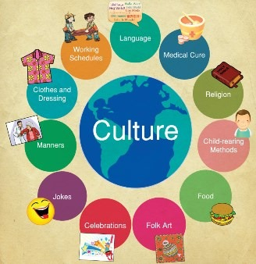
GRAPHICAL REPRESENTATION ON INDIAN CULTURE MANAGEMENT SYSTEM

Slide 6

OBJECTIVES
Preserve Indian culture
Manage Indian culture
Educate people about Indian culture
Create opportunities for cultural learning
Celebrate cultural diversity

Slide 7
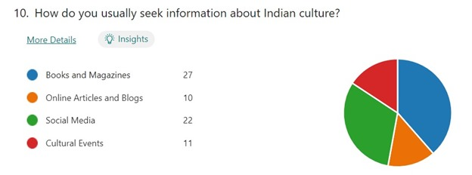
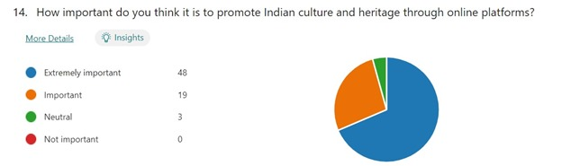
SURVEY RESULTS:

Slide 8
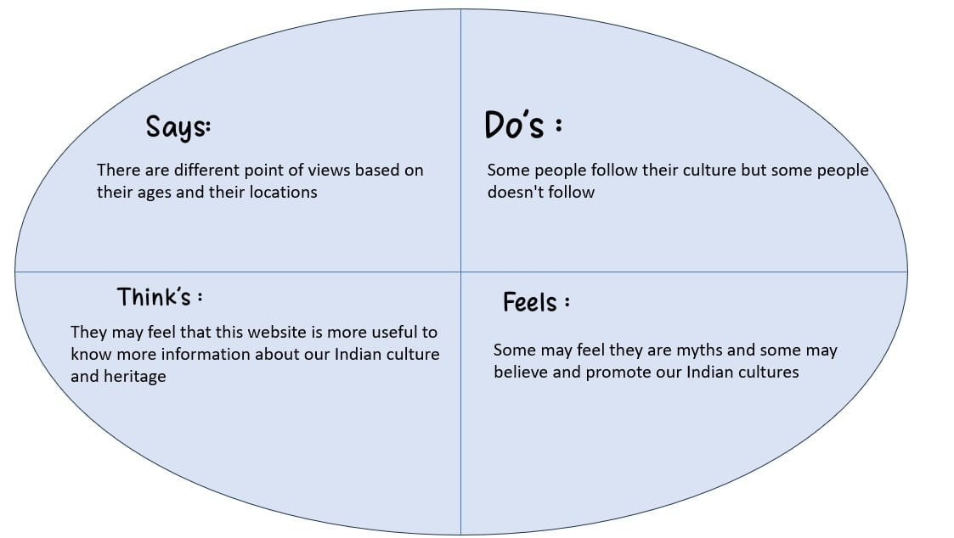
EMPATHY MAP:

Slide 9
MODULES:
Festivals
Traditional Clothing
Cuisine
Architecture
Languages

Slide 10
GOALS
Promotion of Indian Culture
Awareness Generation
Educational Resource
Cultural Exchange Facilitator
Community Building

Slide 11


